Slide 1
Group #2 Milestone #6

Slide 2
Scope
Milestone #1 | Importance of Big Data Security Big Data Security Technologies
Milestone #2 | Big Data Security Risk
Milestone #3 | Big Data Security Use Cases
Milestone #4 | Big Data Security Issues Regulations and Policies
Milestone #5 | Implementation Part 1
Milestone #6 | Implementation Part 2
Milestone #7 | Implementation Part 3

Slide 3
Agenda
Discuss the Sixth Milestone
Discuss about Apache Cassandra
Discuss Cassandra integration to Hadoop
Overview of the integration steps
Conclusion

Slide 4

Overview of Cassandra
What is Apache Cassandra?
Cassandra Advantages over Hadoop
Use cases unsuitable for Cassandra
Cassandra Integration with Hadoop
Commercial Hadoop + Cassandra Solution
https://www.edureka.co/blog/interview-questions/cassandra-interview-questions/
Notes:
Notes:
Hadoop is very powerful for processing large amount of data at rest and has a very powerful MapReduce function. However, it struggles to process data at real-time and suffers from stability and security issues. Cassandra is an Open-Source No-SQL Distributed Database Management System. It was released on Google Code in 2008 and has subsequently become a top-level project at the Apache Software foundation since 2010. One can also implement Cassandra with Hadoop on the same cluster. This means that you can have the best of both worlds.
DataStax, a leading commercial provider for distributions of Cassandra has combined Cassandra with Hadoop and named it Brisk. With Brisk, HDFS is replaced by Cassandra File System.
References:
Paul, S. (2015, June 20). Hadoop Advantages and Disadvantages. Mindmapped.Com. https://www.mindsmapped.com/hadoop-advantages-and-disadvantages/
Edureka. (2020, July 1). Why Learn Cassandra with Hadoop? https://www.edureka.co/blog/why-learn-cassandra-with-hadoop/

Slide 5
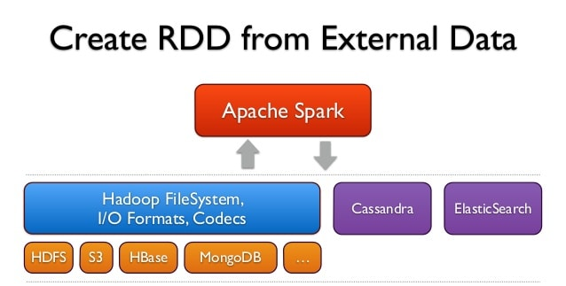
Cassandra-Spark Integration
What is Spark
Spark compatibility with Hadoop
Cassandra compatibility issues
Spark as interface between Hadoop and Cassandra
Datastax Cassandra-Spark connector
https://www.slideshare.net/frodriguezolivera/apache-spark-streaming
Notes:
Notes:
Apache Spark is powerful cluster computing engine, which is purposely designed for fast computation in Big Data world. Spark is compatible with all HDFS When we use standalone deployment, we can statically allocate resources over the cluster. Also, on a subset of machines in a Hadoop cluster. Even we can run spark side by side with Hadoop MapReduce. Afterwards, the user can run arbitrary spark jobs on their HDFS data.
On the other hand, Cassandra is not compatible with HDFS. But Datastax has developed a specialized connector which allows Spark to read and write to Cassandra Database efficiently. This makes it possible for users to deploy Hadoop and Cassandra as two standalone systems and use Spark as an interface between them.
References:
TechVidvan. (2021, June 30). Hadoop Spark Compatibility: Hadoop+Spark better together. https://techvidvan.com/tutorials/hadoop-spark-compatibility/

Slide 6
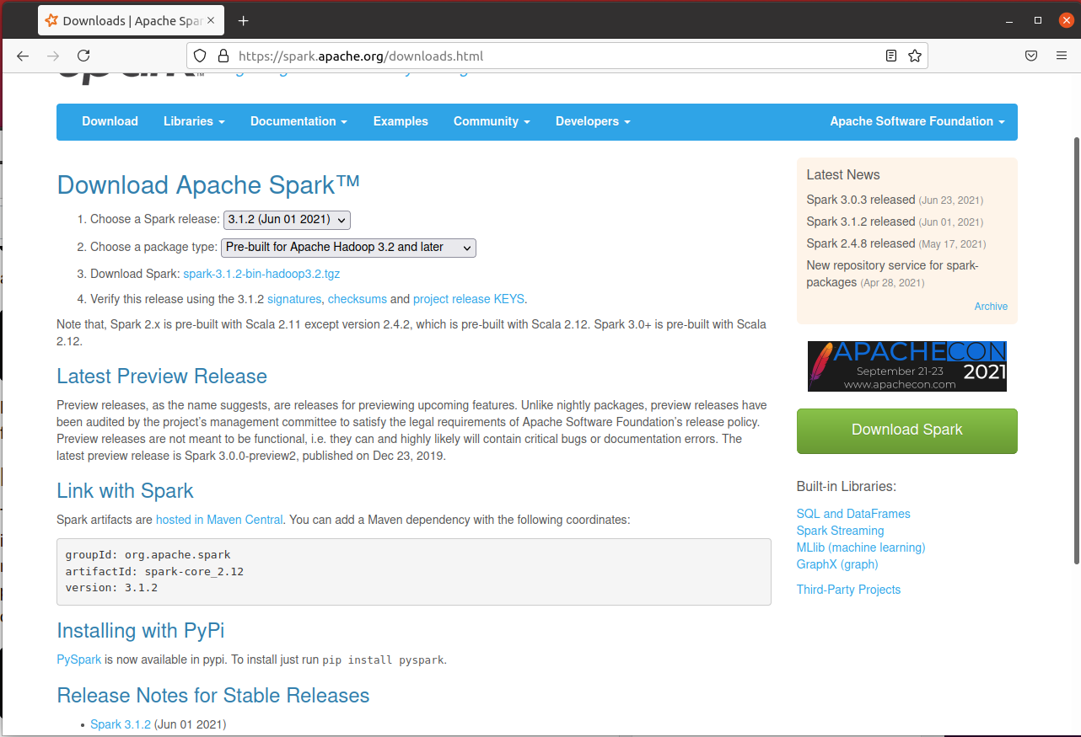
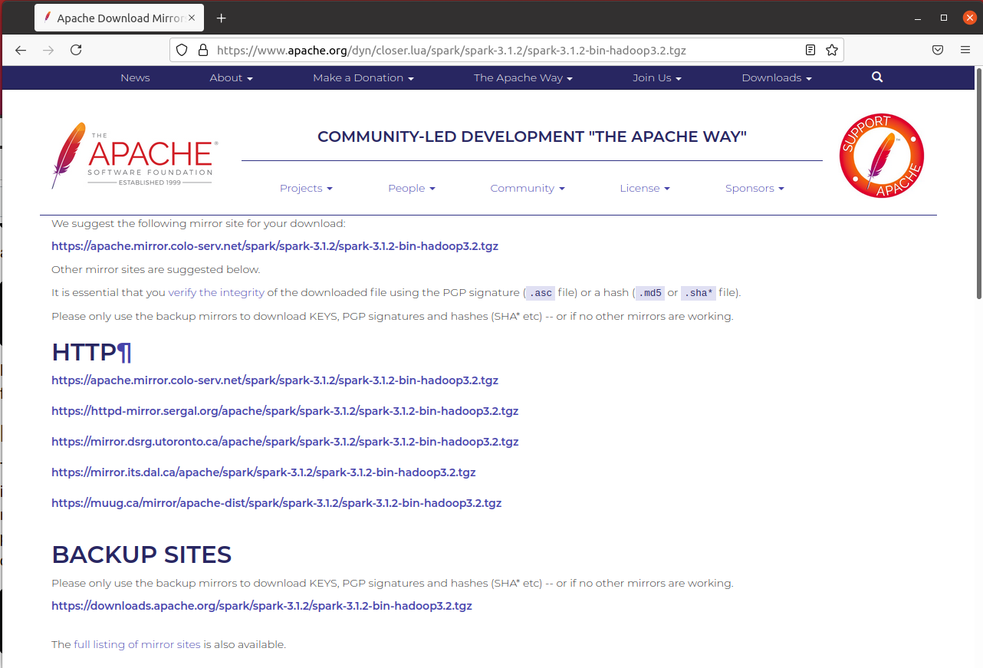
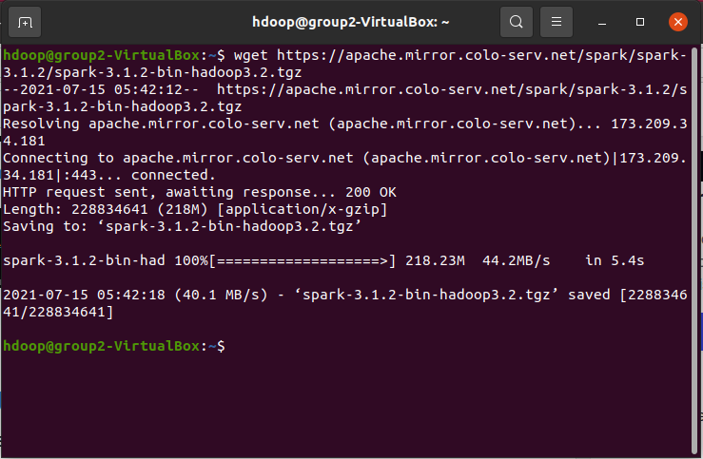
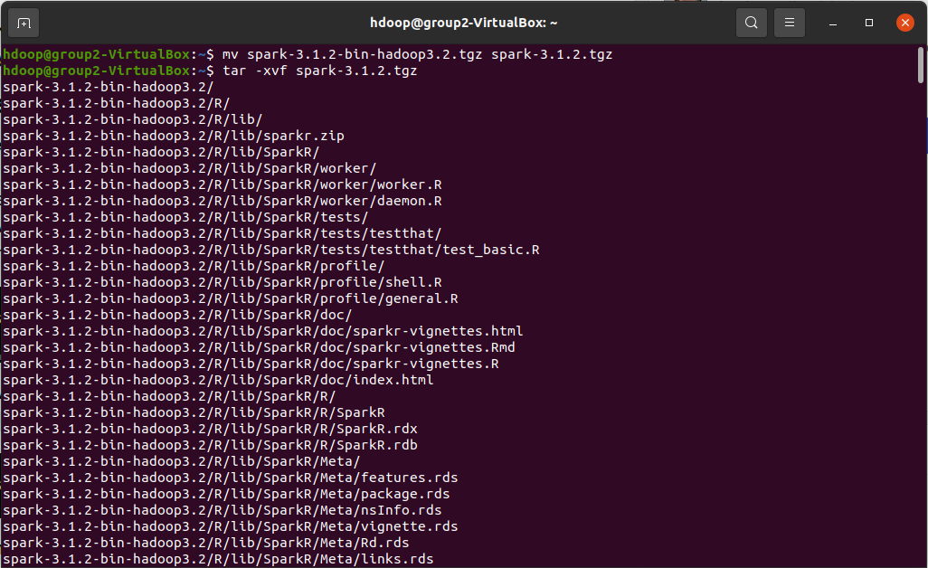
Downloading Spark
Go to Official Download Page
Get the url for Spark Package
Download the tar file
Verify the file integrity (recommended but optional)
Extract the tar file
Notes:
Notes:
Previously we have installed Ubuntu and Hadoop on a Virtual Machine. Now we will install Spark as a standalone cluster. First, we need to visit Spark’s official website https://spark.apache.org/ to download the latest package. In the Download section, copy the url to the correct spark package and open the terminal. Now use curl or wget to download the tar package in your system. Now before we move on to the installation, we can verify the integrity of the package by its checksum. Users can see the checksum of the package on the website and match it with the checksum generated from the downloaded package using md5sum command on linux terminal.
Once the integrity has been verified, extract the tar file using the “tar –zxvf filename” command.
References:
Tucakov, D. (2020, April 13). How to Install Spark on Ubuntu. PhoenixNAP. https://phoenixnap.com/kb/install-spark-on-ubuntu

Slide 7
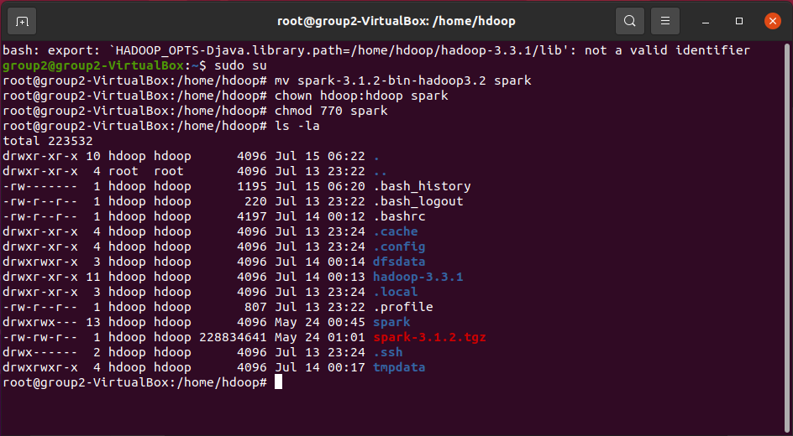
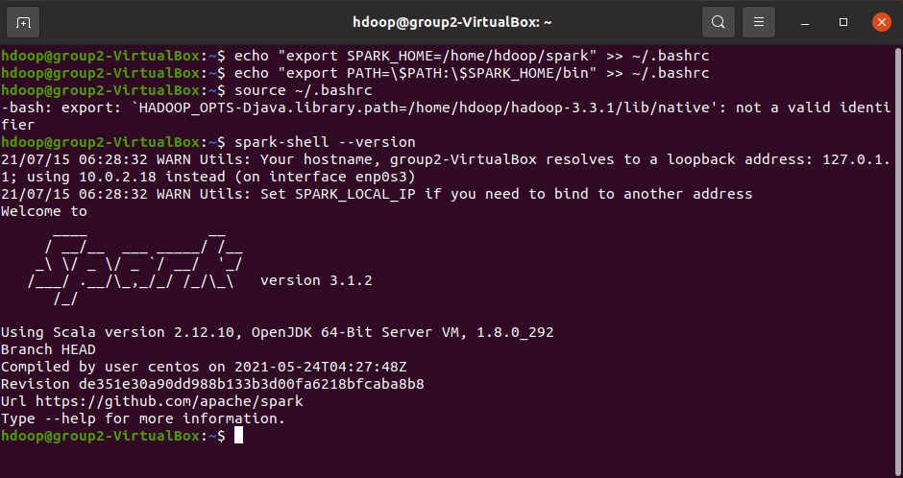
Spark Configuration
Use chown to set owner of the package
Use chmod to set permissions as 770
Verify the owner and permission
Export the Spark directory path to bash shell and reload it
Check spark version to confirm setup success
Notes:
Notes:
After extracting the package, specify the owner and group of the directory as hdoop (or the user you created during last part of implementation) using the command “chown hdoop:hdoop directoryname”. Now set the permission of the file as 770. Which means we give all permission to user and group, which is only hdoop, and do not allow any permission to other users.
Now we need to add the Spark Directory path to our Bash Shell so that we can use Spark from anywhere.
Use the following command to add SPARK_HOME and Spark PATH variables to Bash Shell.
echo “export SPARK_HOME=/home/hdoop/spark” >> ~/.bashrc
echo “export PATH=\$PATH:/$SPARK_HOME/bin” >> ~/.bashrc
References:
Tucakov, D. (2020, April 13). How to Install Spark on Ubuntu. PhoenixNAP. https://phoenixnap.com/kb/install-spark-on-ubuntu

Slide 8
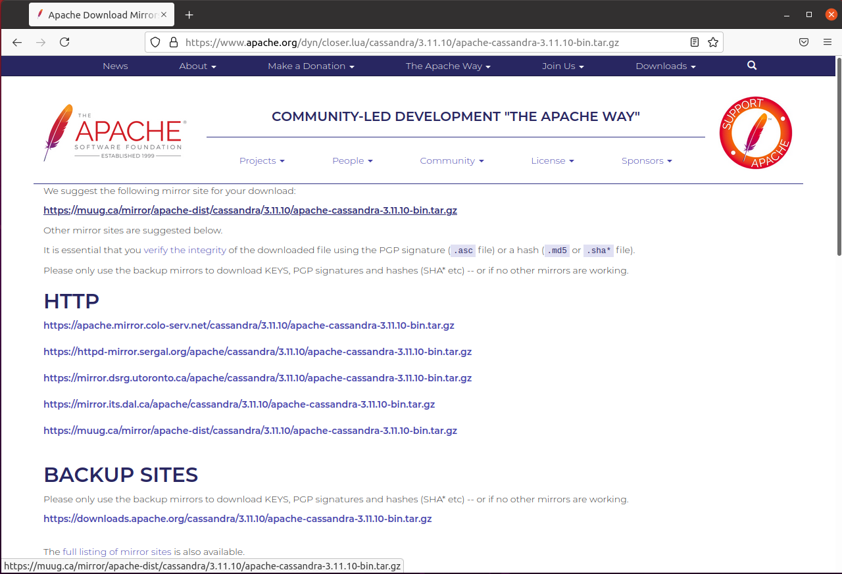
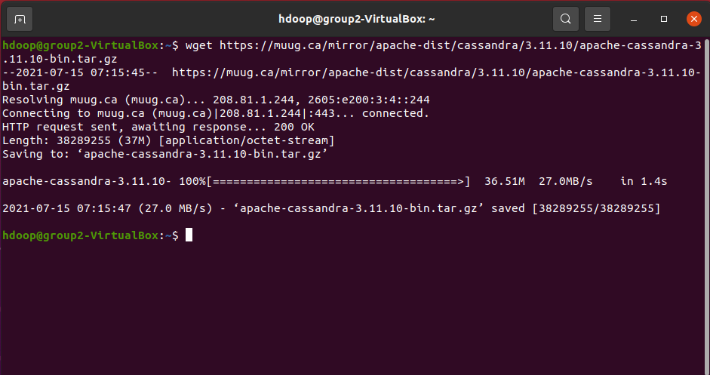
Downloading Cassandra
Go to Official Cassandra Page
Get the url for Cassandra Package
Download the tar file
Verify the file integrity (recommended but optional)
Extract the tar file as before
Notes:
Notes:
Now we will install Cassandra as a standalone cluster as well. The steps for installing Cassandra are almost the same as Spark. First, we need to visit Cassandra’s official website https://cassandra.apache.org/ to download the latest package. In the Download section, copy the url to the correct cassandra package and open the terminal. Now use curl or wget to download the tar package in your system. Now before we move on to the installation, we can verify the integrity of the package by its checksum. Users can see the checksum of the package on the website and match it with the checksum generated from the downloaded package using md5sum command on linux terminal.
Once the integrity has been verified, extract the tar file using the “tar –zxvf filename” command.
References:
Apache. (n.d.). Cassandra Documentation. Retrieved July 16, 2021, from https://cassandra.apache.org/doc/latest/getting_started/installing.html

Slide 9
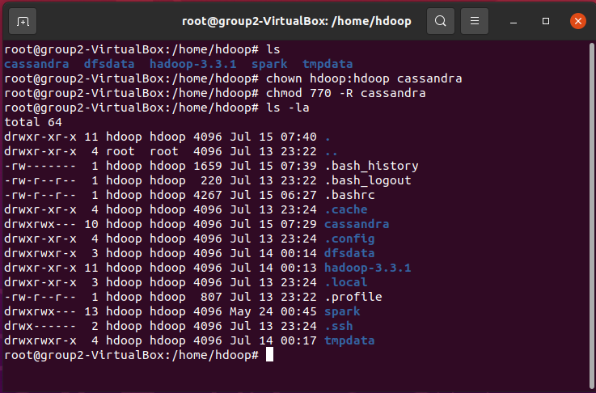
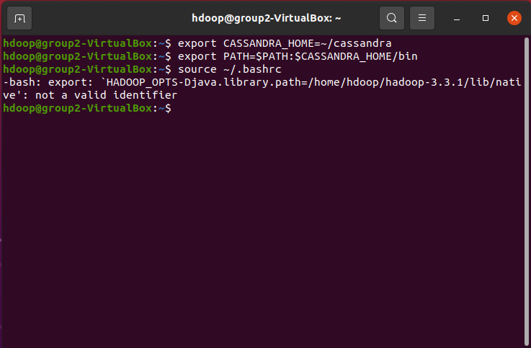
Cassandra Configuration
Use chown to set owner of the package
Use chmod to set permissions as 770
Verify the owner and permission
Export the Cassandra directory path to bash shell
This concludes the Cassandra setup
Notes:
Notes:
Again, after extracting the package, specify the owner and group of the directory as hdoop (or the user you created during last part of implementation) using the command “chown hdoop:hdoop directoryname”. Now set the permission of the file as 770. Which means we give all permission to user and group, which is only hdoop, and do not allow any permission to other users.
Now we need to add the Cassandra Directory path to our Bash Shell so that we can use Cassandra from anywhere.
Use the following command to add CASSANDRA_HOME and Cassandra PATH variables to Bash Shell.
echo “export CASSANDRA_HOME=/home/hdoop/cassandra” >> ~/.bashrc
echo “export PATH=\$PATH:/$CASSANDRA_HOME/bin” >> ~/.bashrc
References:
Apache. (n.d.). Cassandra Documentation. Retrieved July 16, 2021, from https://cassandra.apache.org/doc/latest/getting_started/installing.html

Slide 10
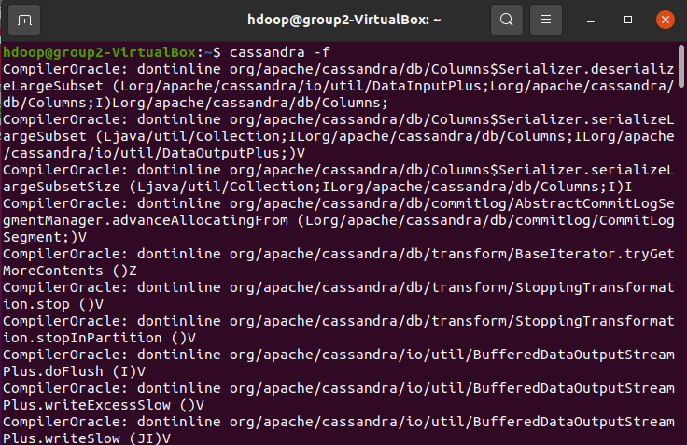
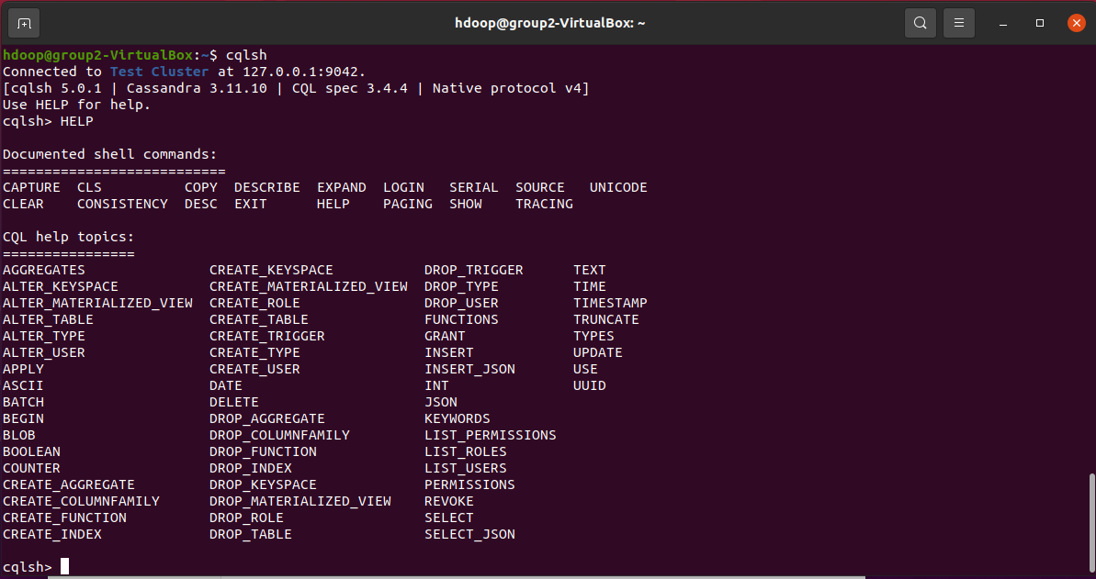
Starting Cassandra
To start Cassandra, just type “cassandra” in terminal.
You can use –f to start it in foreground.
Check the status of Cassandra server.
Run the CQL Shell.
Check the available options.
Notes:
Notes:
Now that Cassandra is successfully installed, we can test if it is successful by just typing “cassandra” in the terminal. It will initiate the Cassandra Server and you can use it on another terminal. You can even use –f to run Cassandra in the foreground. If you want to check the status of the Cassandra server, you can just use the command “nodetool status”.
When the Cassandra server is running, we can use the CQL Shell to manipulate the Cassandra Database. To access the CQL Shell, just enter the command “cqlsh” while the Cassandra server is running. It should be noted that cqlsh requires python to operate.
References:
Apache. (n.d.). Cassandra Documentation. Retrieved July 16, 2021, from https://cassandra.apache.org/doc/latest/getting_started/installing.html
Learning Journal. (n.d.). Spark Cassandra Connector - Learning Journal. Retrieved July 16, 2021, from https://www.learningjournal.guru/courses/spark/spark-foundation-training/spark-cassandra-connector/

Slide 11
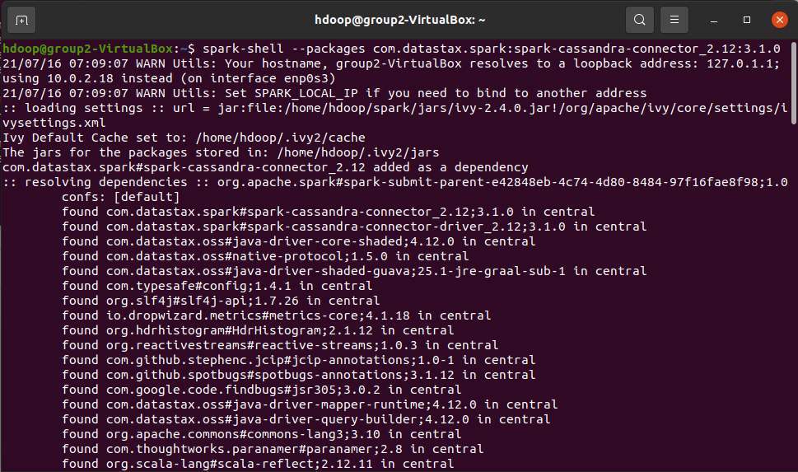
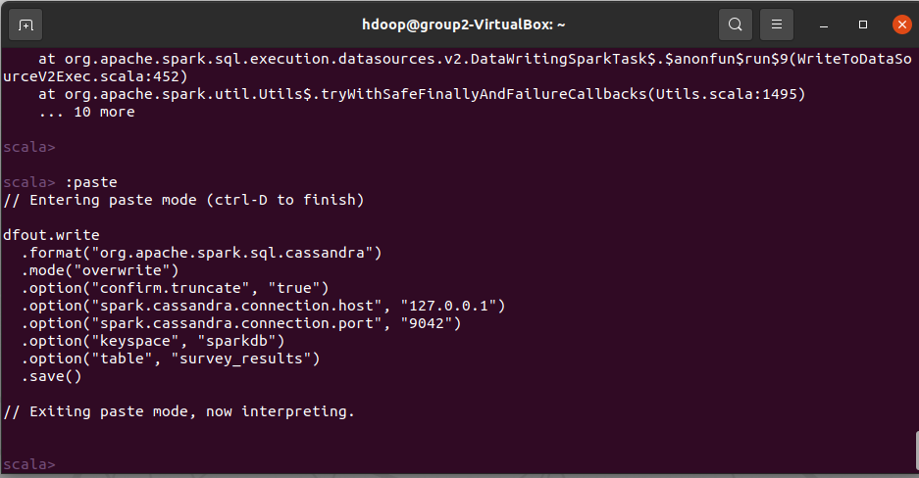
Sending Data to Cassandra
Understanding Cassandra Databases.
Prerequisites for data transfer between Cassandra and Spark.
Start Cassandra-Spark Connector.
Send Data from Spark to Cassandra.
Verify the data in Cassandra.
Notes:
Notes:
Cassandra uses CQL i.e., Cassandra Query Language. Cassandra might be a No-SQL database, but CQL is very similar to SQL which makes it very easy for anyone who knows SQL to start working on CQL. The Databases in Cassandra are called as Keyspaces. These Keyspaces can contain multiple tables of data. Typing “HELP” command in the cqlsh will display the help option which lists all the available commands and their descriptions.
Now to send data from Spark to Cassandra, we need to start the Cassandra-Spark Connector in Spark-Shell. The command to do that depends upon the version combination you are using and can be found on the following page:
https://github.com/datastax/spark-cassandra-connector.
After running the command, you will enter Scala shell. Now we are ready to send data to Cassandra. There is another thing we must be aware of, sending and receiving data from databases of Spark and Cassandra requires that both the tables have the same schema.
First we add some sample data in the spark from a script that we made and then we copy the function to send this data to Cassandra table. All the details can be seen in the script. After executing the code, we can verify the data in the Cassandra table.
If you would like to check the script and the sample data, please visit this GitHub link: https://github.com/DmC324725/CYT300_Project
References:
Learning Journal. (n.d.). Spark Cassandra Connector - Learning Journal. Retrieved July 16, 2021, from https://www.learningjournal.guru/courses/spark/spark-foundation-training/spark-cassandra-connector/

Slide 12
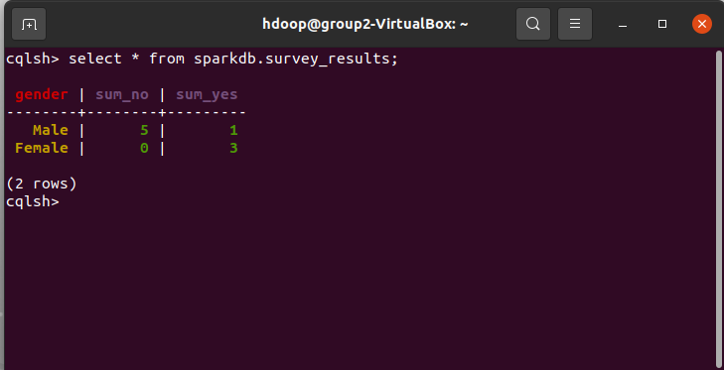
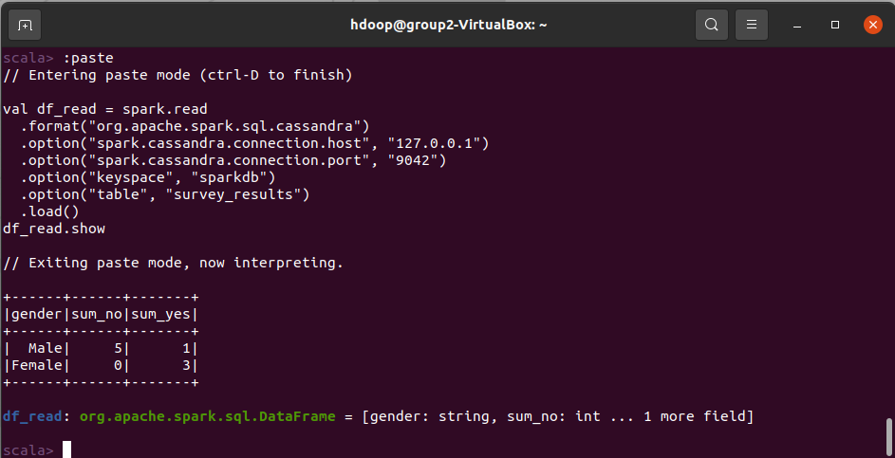
Reading Data from Cassandra
Check the data previously sent from Spark in Cassandra.
Paste the code from Script in Spark Shell.
Spark will read the Cassandra Database.
Verify the output in Spark Shell.
Notes:
Notes:
Reading the data from Cassandra is also quite simple. This will also be done via Scala from Spark Terminal. First we check the data stored in the Cassandra table. Then we paste the code to read this table data into Spark and display it on the screen. The output from this should match the table data we checked in Cassandra.
References:
Learning Journal. (n.d.). Spark Cassandra Connector - Learning Journal. Retrieved July 16, 2021, from https://www.learningjournal.guru/courses/spark/spark-foundation-training/spark-cassandra-connector/

Slide 13

Conclusion
In this way, we could implement three powerful data analytics which could function independently and can share the necessary data between them without any issue.
This configuration will allow the company to utilize the powerful MapReduce functionality of Hadoop while also employing the great Read-Write Performance and Non-Relational Data Processing capabilities of Cassandra.
https://arjon.es/2015/making-hadoop-2.6-spark-cassandra-driver-play-nice-together/
Notes:
Notes:
References:

